Slide 1
FOOD WEBSITE ANALYSIS
Audience analysis x audience prediction thanks to meteo datas

Slide 2
OBJECTIVES
ANALYZE…
Website audiences evolution
Geographic impact on the audience
Audience engagement evolution accross 2021
Meteo impact on the audience
PREDICT…
Website audience by recipe type on the next few days

Slide 3
METHODOLOGY
This analysis is based on different data sources:
Meteo data per french region in 2021
Behaviour audience data on our webistes (from Google Analytics)

Slide 4



EXECUTIVE SUMMARY
AN AUDIENCE
Mostly mobile first
They enjoy watching videos when they’re looking for a recipe
Differences between regions are mostly due to french population repartition
AN IMPACTFULL SEASONALITY
Audience performances depend on months and events
There is less audience consulting our website during summer
1,8
PREDICTION: VALIDATED
Prediction mostly based on website historical datas
Temperature has more impact on pageviews prediction than rain

Slide 5
Website KPI overview
215K
Unique recipes available on the website
174
Aggregated in x recipe groups
Recipes repartition
34M
Monthly average number of pageviews
22M
Monthly average number of unique visitors

Slide 6
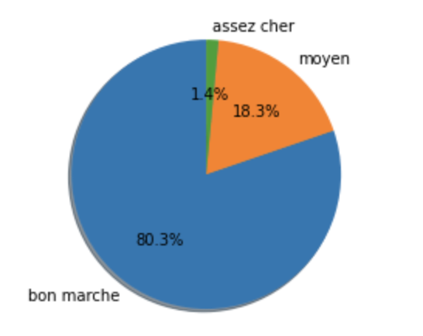
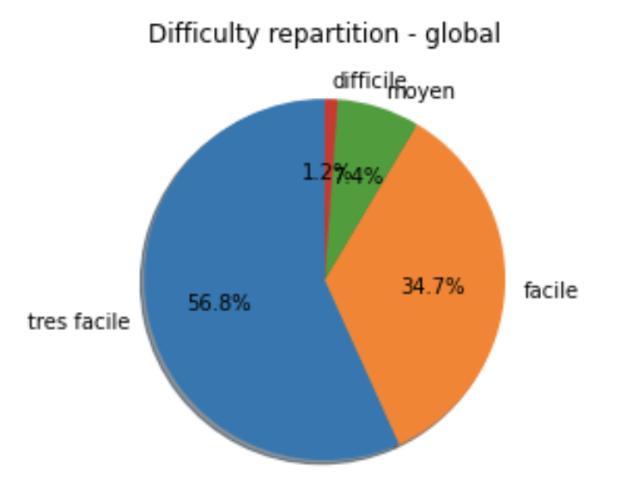
Most of the recipes are easy and cheap
Recipes repartition

Slide 7
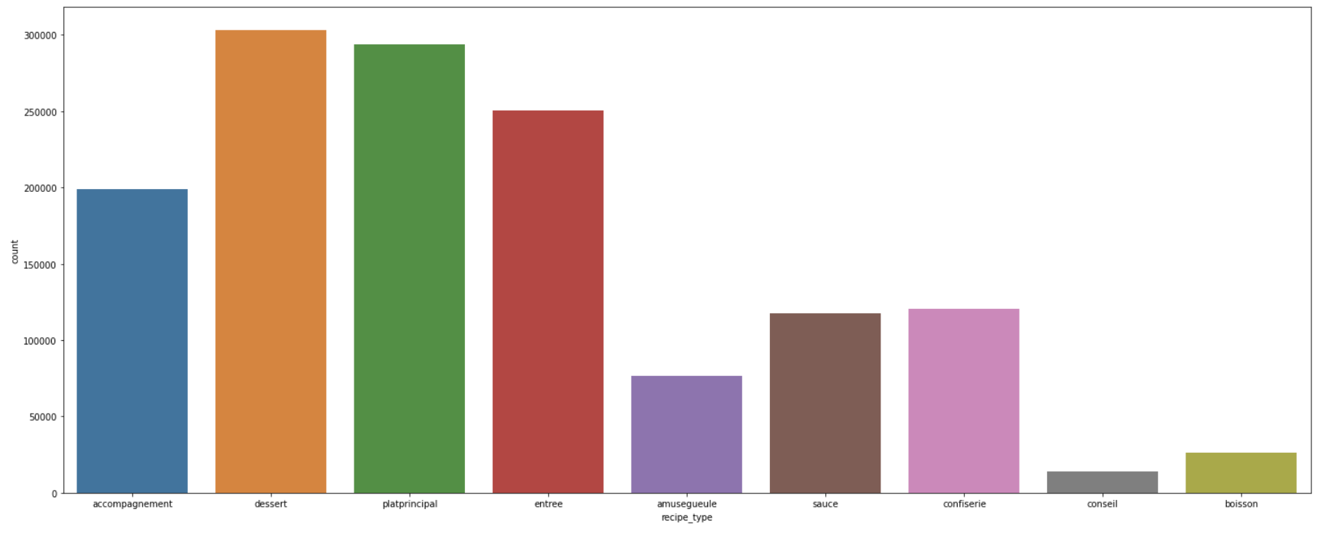
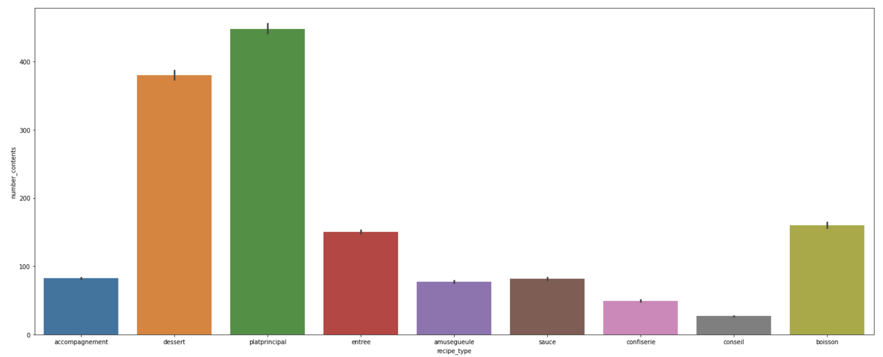
Entrée & accompagnement recipes: not a big success,
Recipes TOP3: Plat principal / dessert / boisson
Recipes repartition by recipe_type
Recipes repartition
Pageviews by recipe_type

Slide 8
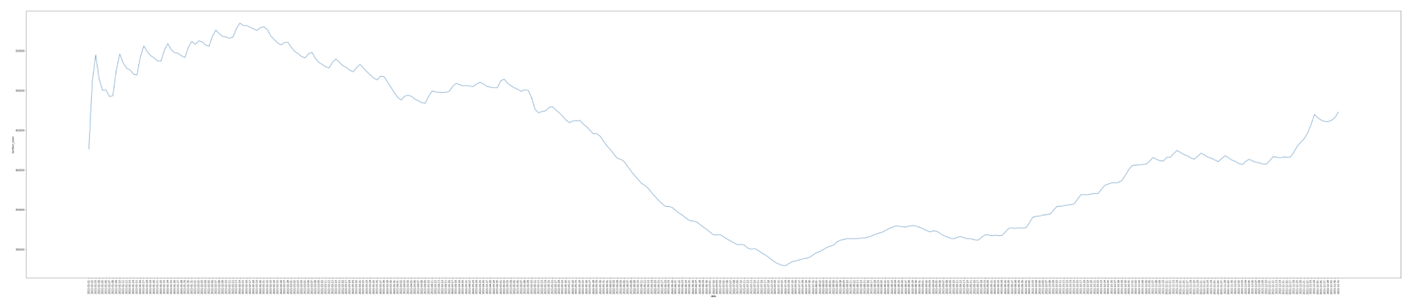
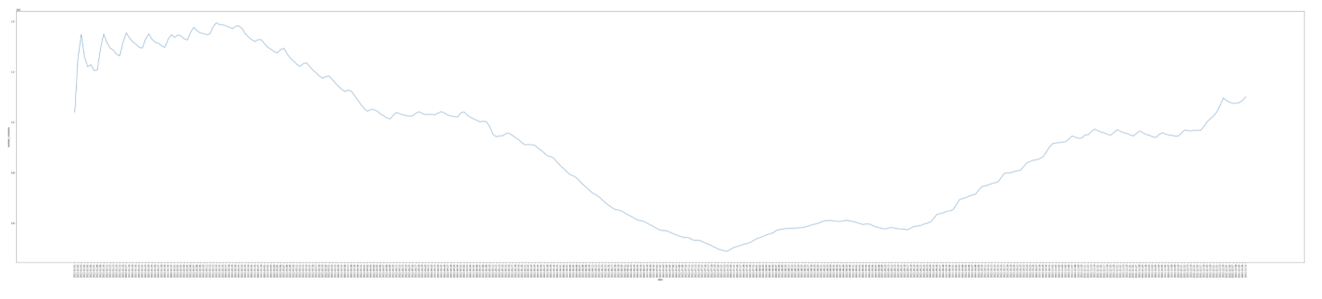
Seasonality : Audience does not consul
Audience
Audience & traffic evolution across 2021
Epiphany
Valentine’s day
Easter
Halloween
Xmas
Chandeleur
NYE
Pageviews

Slide 9
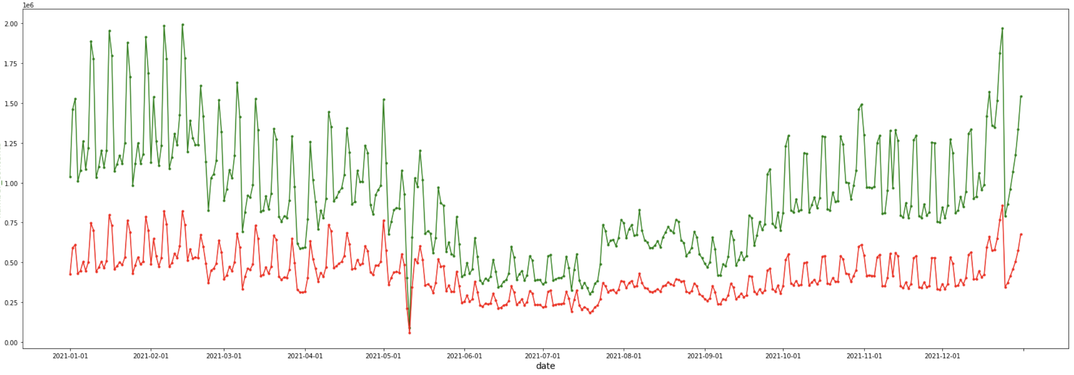
We have the same tendances between the audience and the pageviews
Audience vs traffic evolution across 2021
Pageviews
Audience

Slide 10
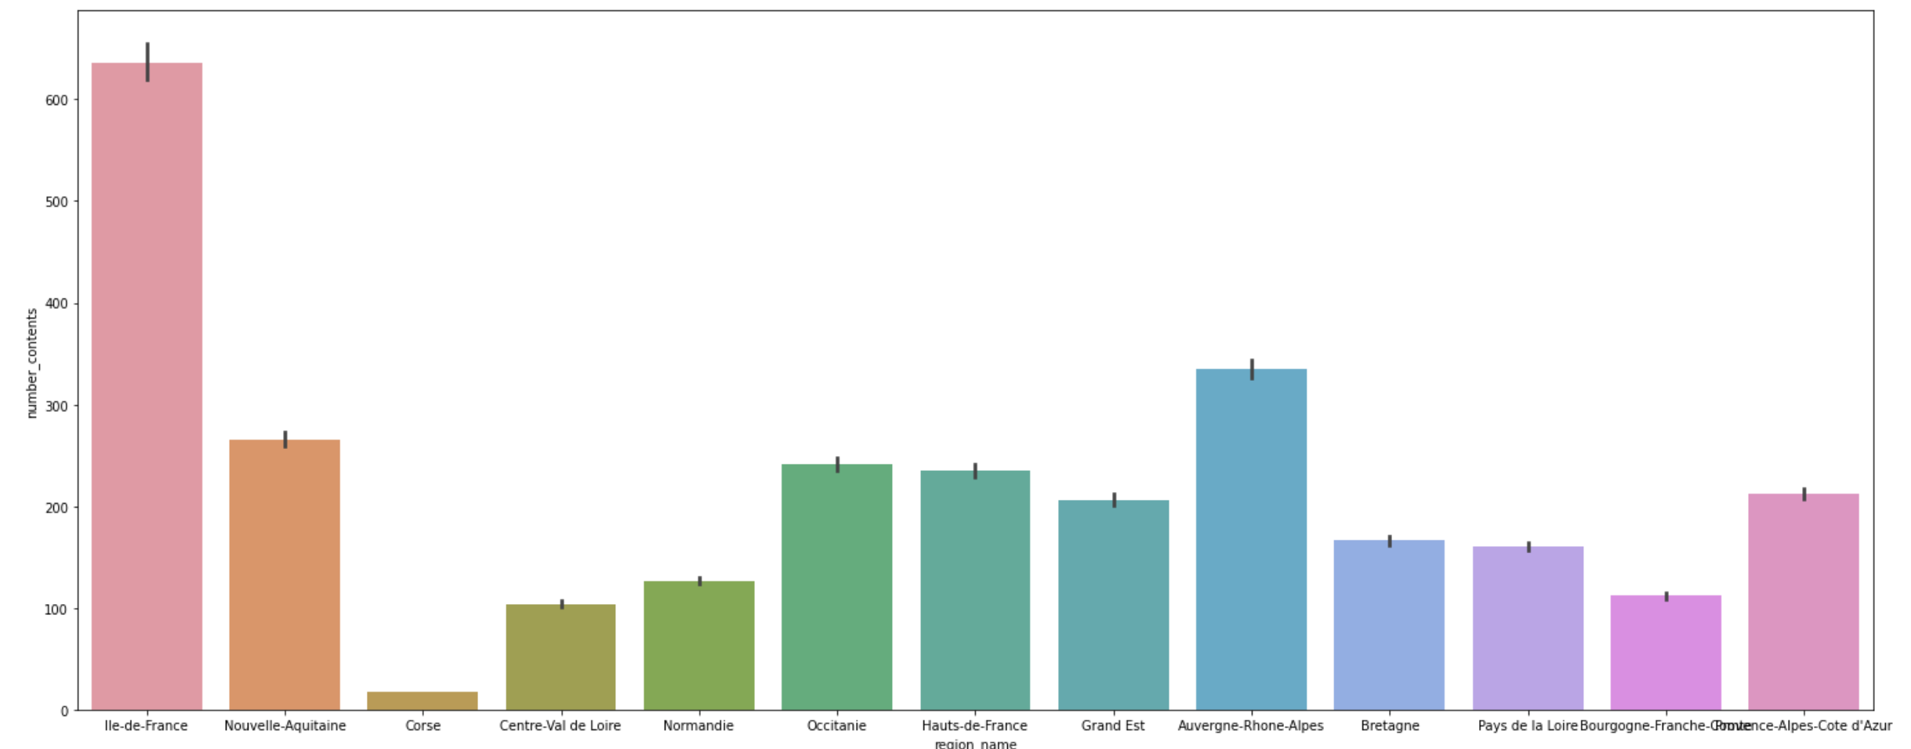
Pageviews repartition is similar to French population repartition
Pageviews repartition

Slide 11
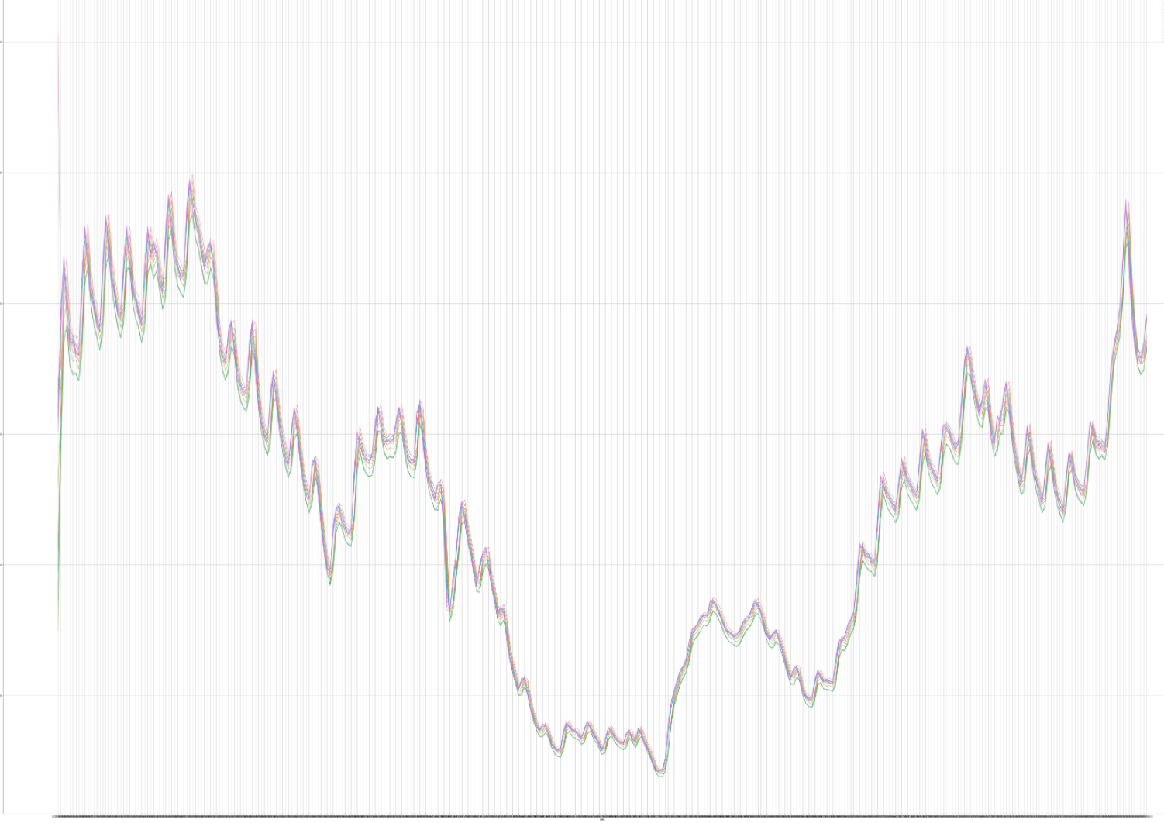
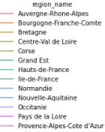
There is no difference between the regions
Pageviews evolution across 2021

Slide 12
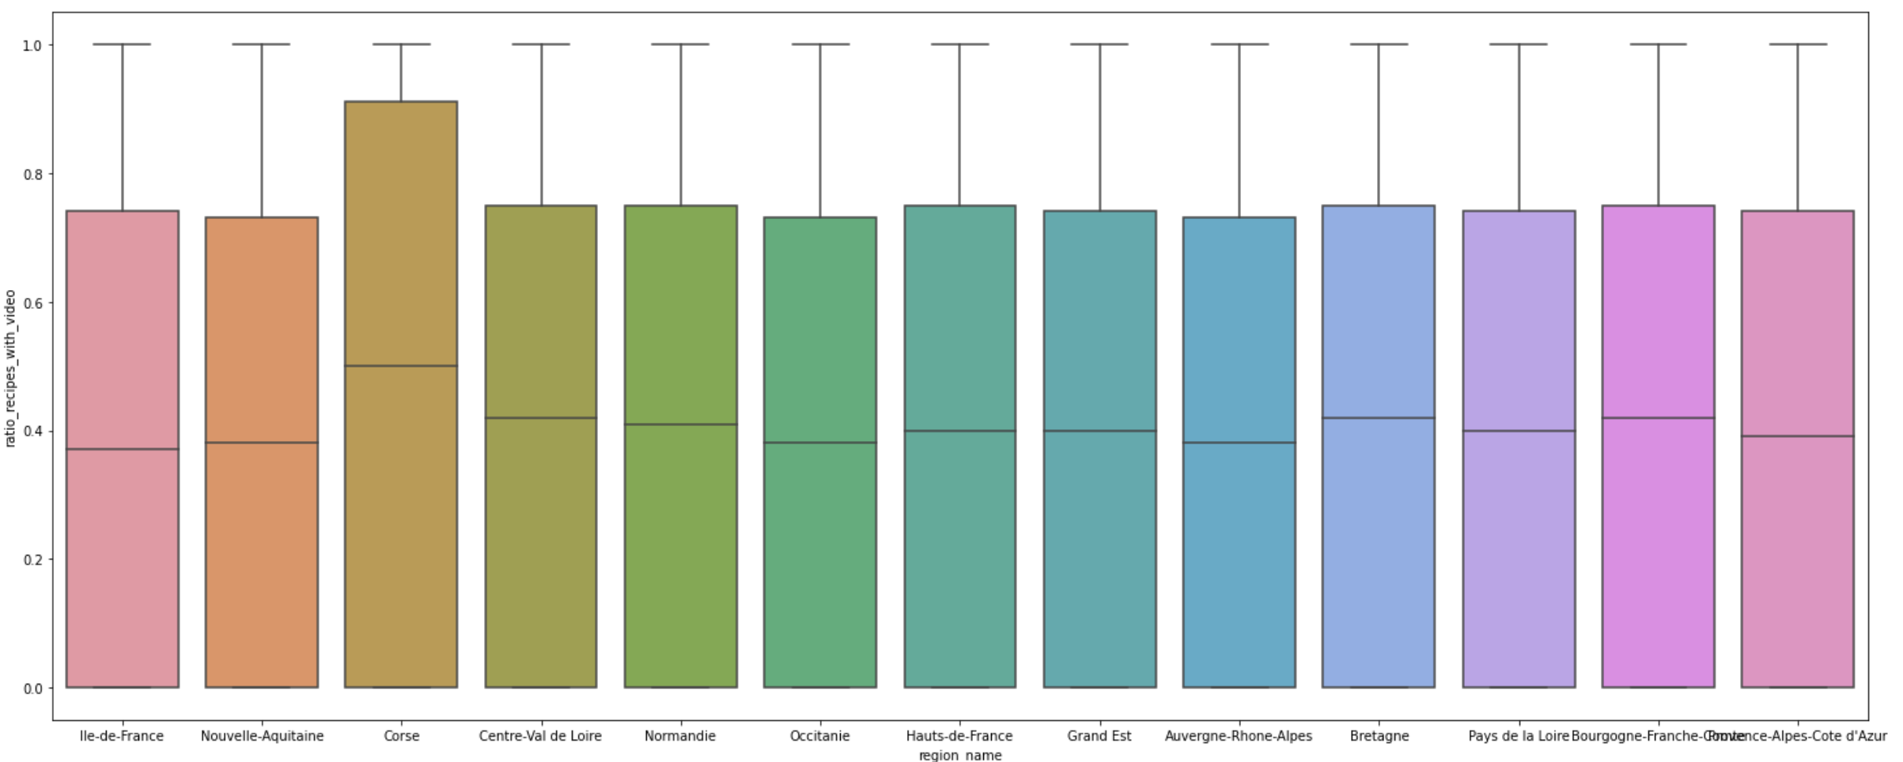
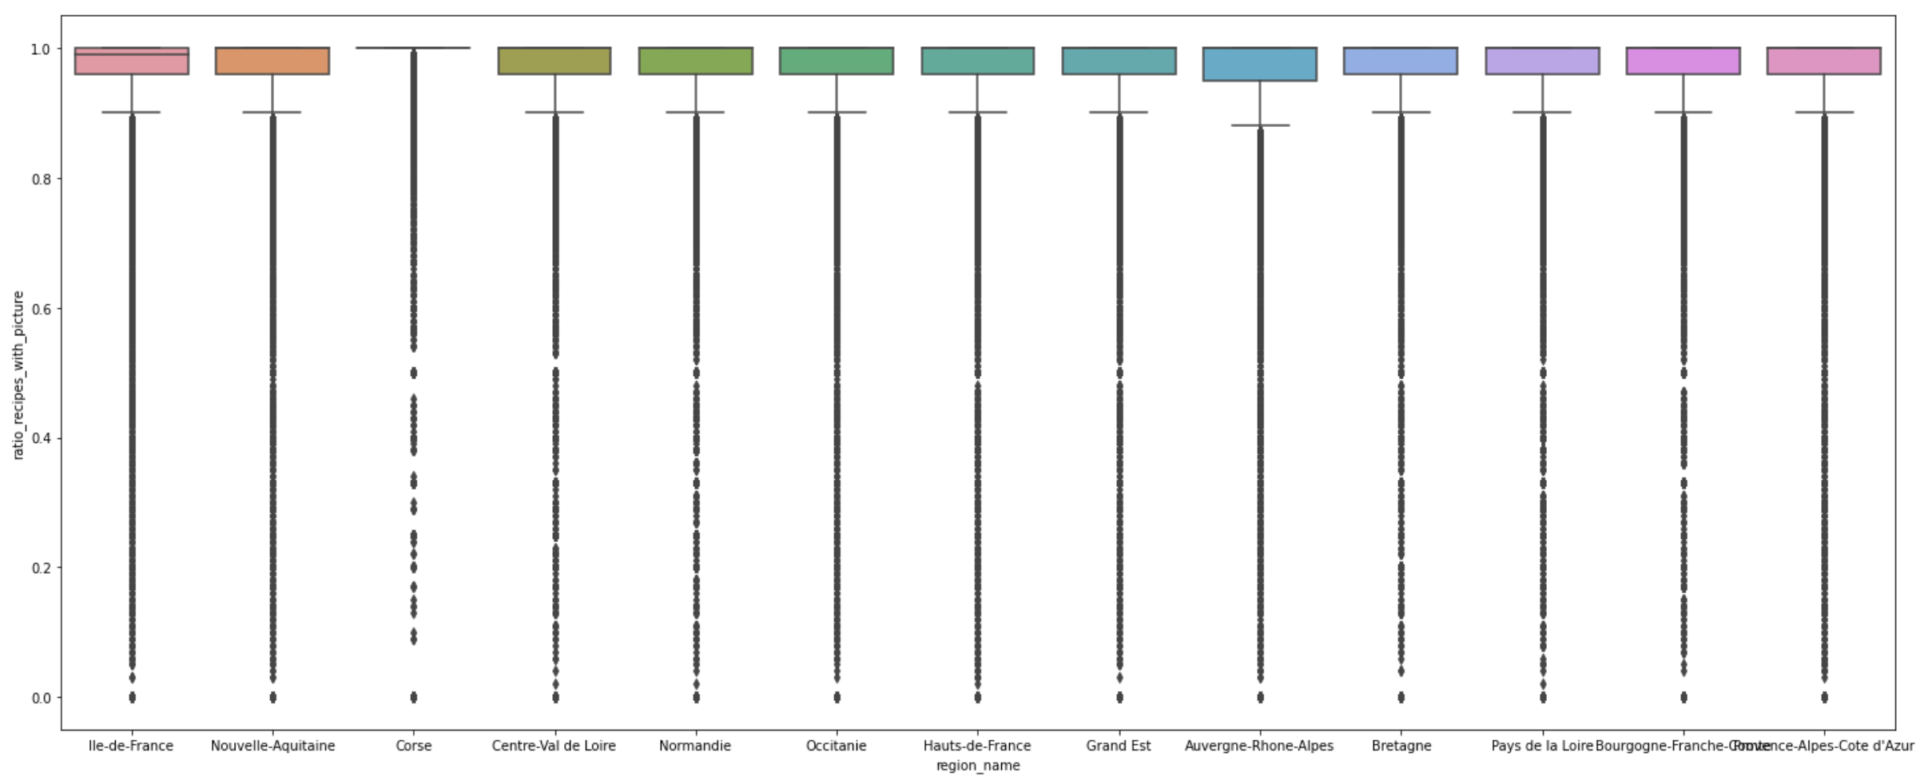
Corsica is the region the most engaged on recipes containing videos
Recipes with video
Recipe formats accross regions
Recipes with picture

Slide 13
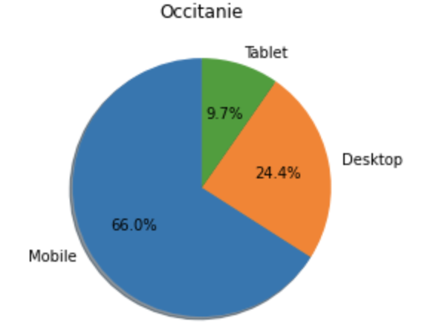
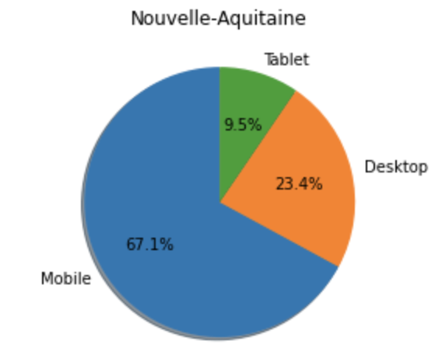
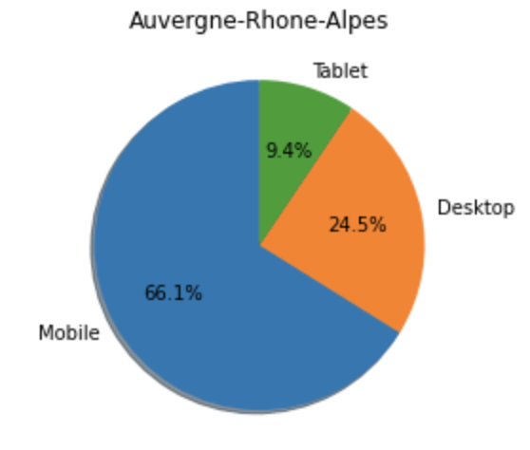
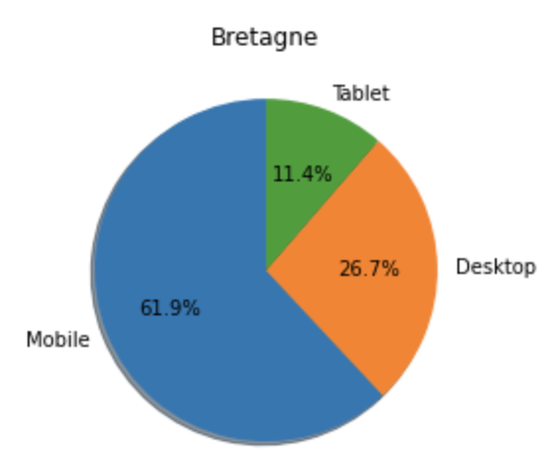
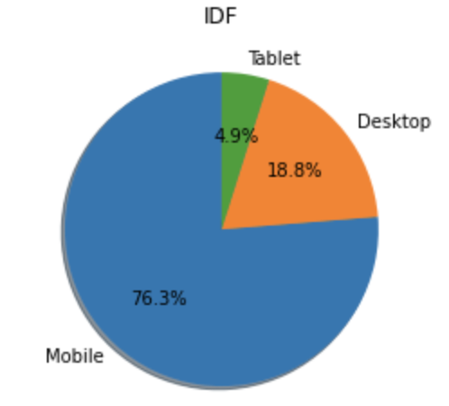
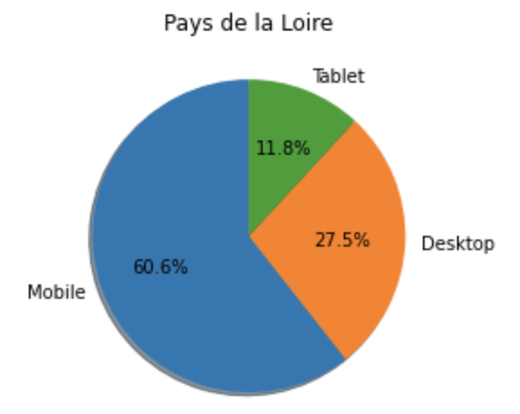
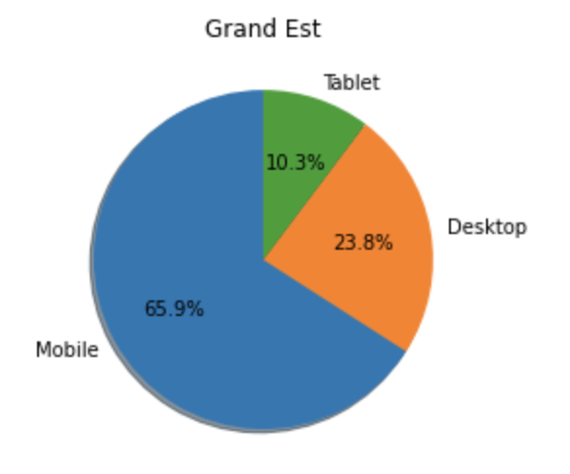
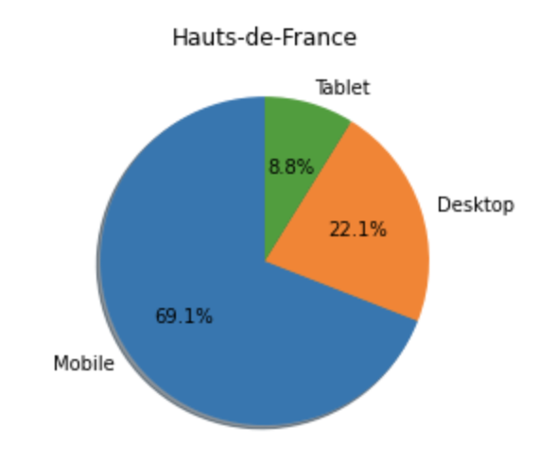
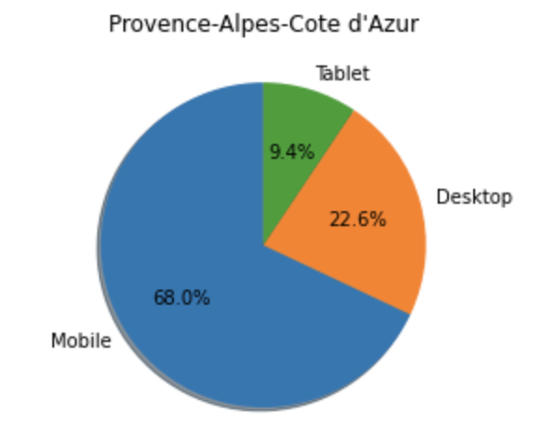
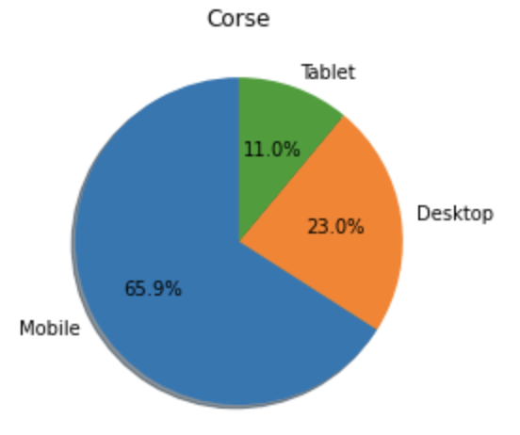
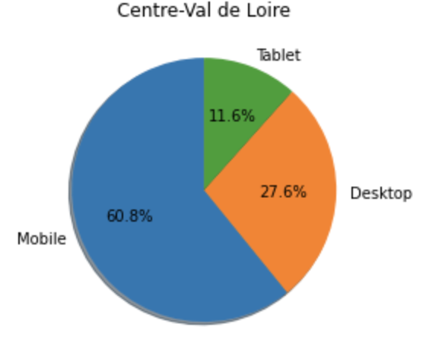
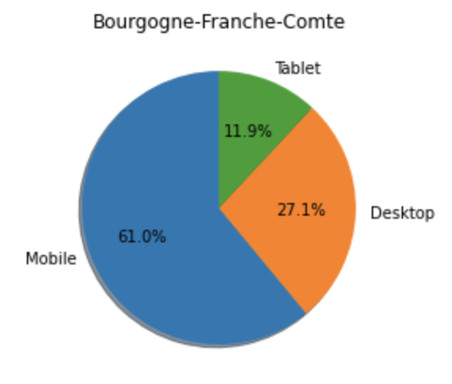
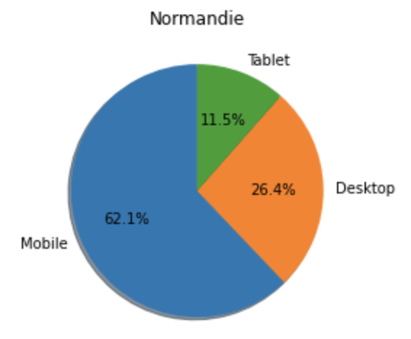
IDF and the north regions are more using their mobile than others
Device repartition

Slide 14
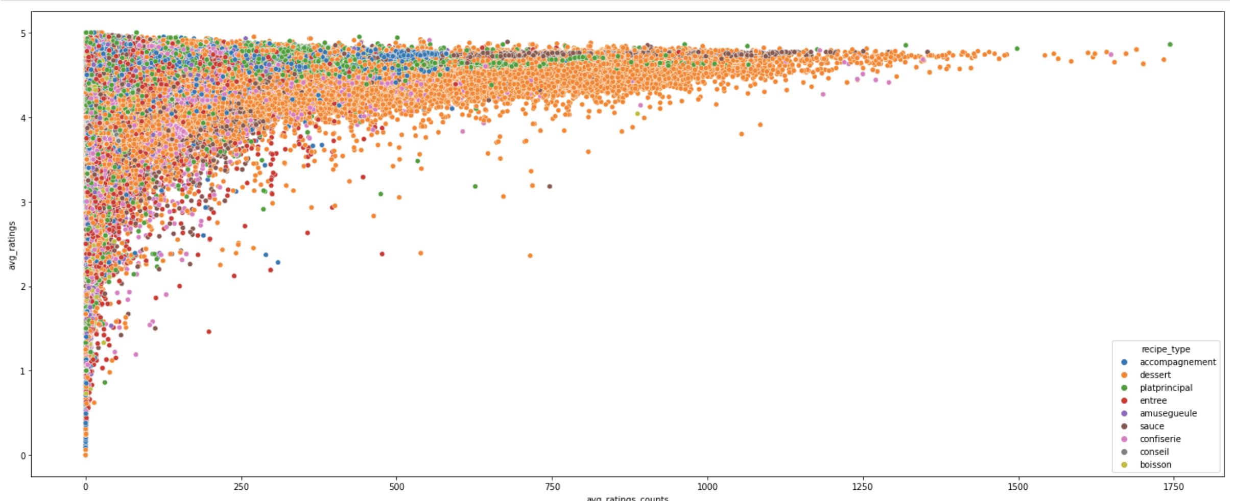
Most of the recipes have very high ratings
Ratings accross recipe type

Slide 15
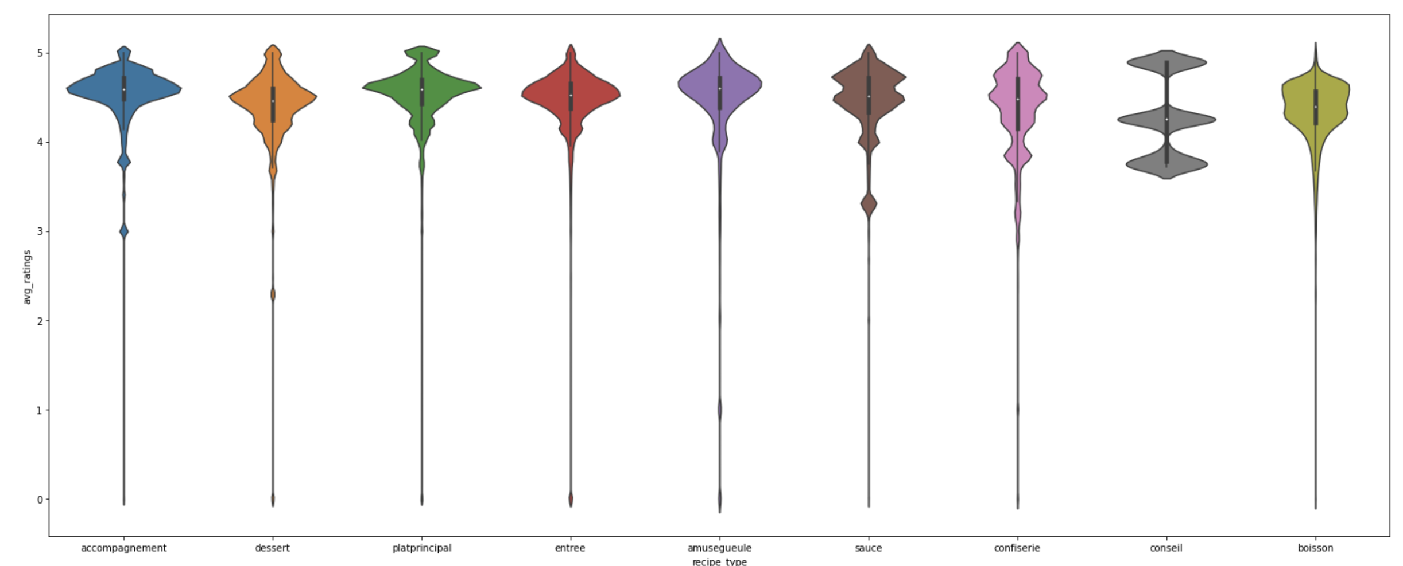
Accompagnement & Plat principal have the highest ratings
Ratings accross recipe types

Slide 16
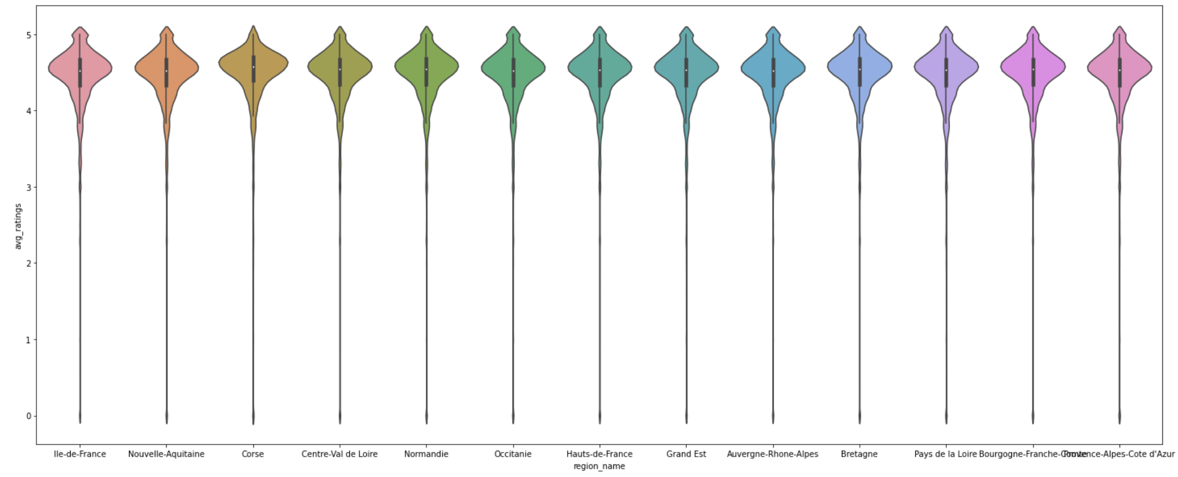
There is no difference in ratings according to regions
Ratings accross regions

Slide 17
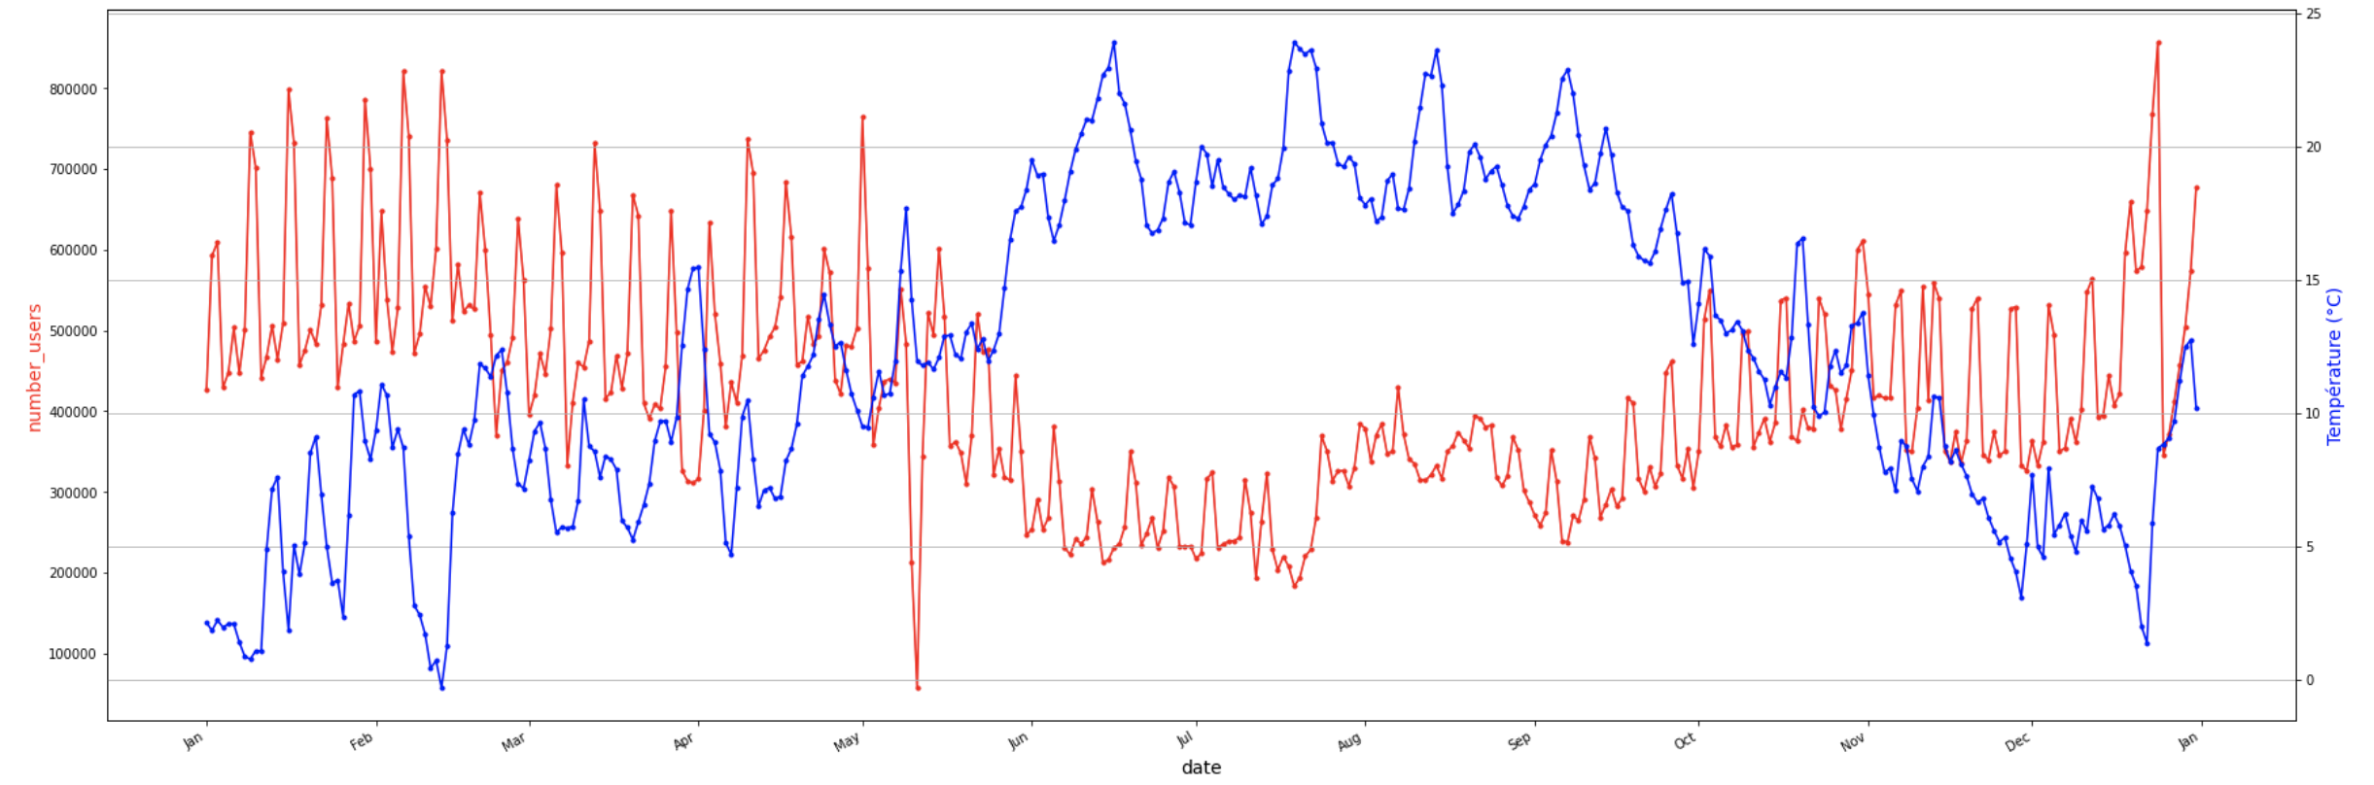
More the temperature is high, more the audience is low
Audience vs Temperature

Slide 18
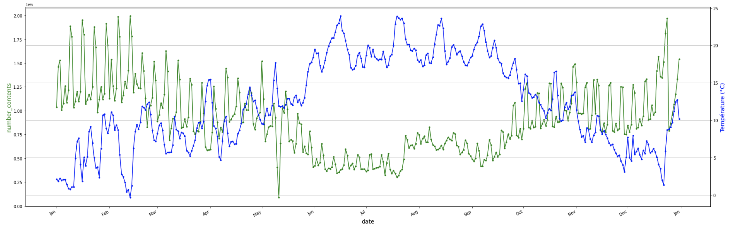
We have the same tendance for the pageviews than for the audience
Audience vs Temperature

Slide 19
PREDICTIONS

Slide 20
After testing many of models and features, we found the good one
Random Forrest Regressor
Added features:
Pageviews evolution rate on the last 2 days
Users evolution rate on the last 2 days
Pageviews average on the last 2 days
Users averages on the last 2 days
All the average ratio (device / recipe difficulty / cost / video / picture …)
Deleted features:
Number of pageviews
Number of users
All the ratio (device / recipe difficulty / cost / video / picture …)
Categorial datas encoding
Transform pagelvl4 text datas to numerical vectors to focus on most important words
16%
Predictive model

Slide 21
GOING FURTHER
Analyze the meteo impact on audience engagement (time on site, number of page / sessions etc)
ANALYSIS
Analyze the impact of holidays by regions on specific dates
ANALYSIS
Implement this predictive model in production
PRODUCTION
Follow the predictive model performances and optimize it
OPTIMIZE
Use this model to predict which recipes we can put in homepage to maximize audiences
OPTIMIZE
Use this model to adapt advertising pricing on top recipes
OPTIMIZE

